Slide 1
The Cederholm-Brorström Connection - One of My Best Success Stories Using DNA on Ancestry.com
Burks Oakley II
burkso2@gmail.com
http://www.burksoakley.com/

Slide 2
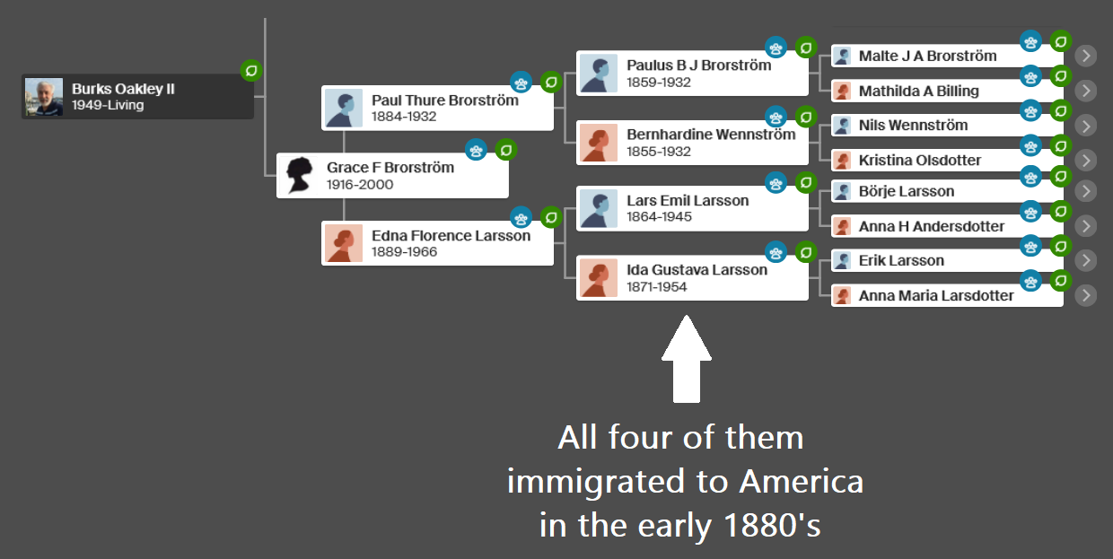

Slide 3
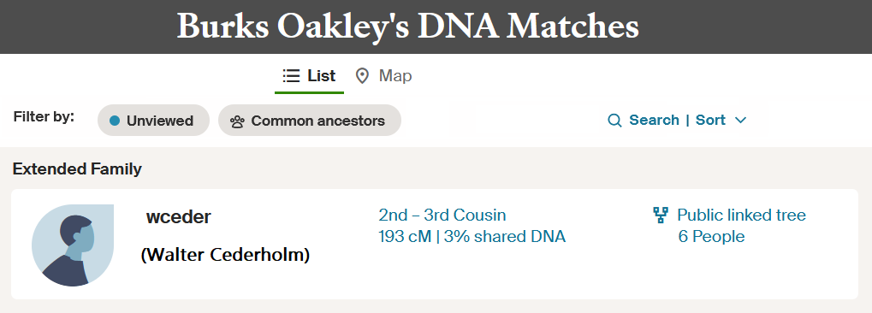
Walter & I share 193 cM of DNA

Slide 4
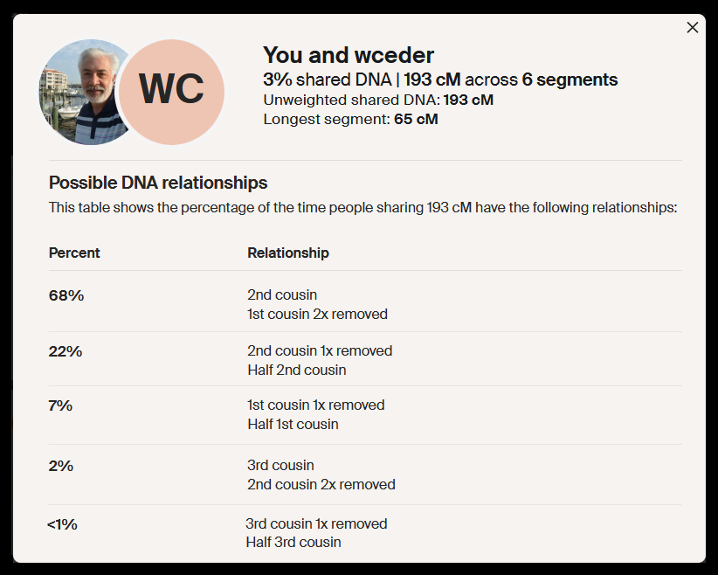

Slide 5
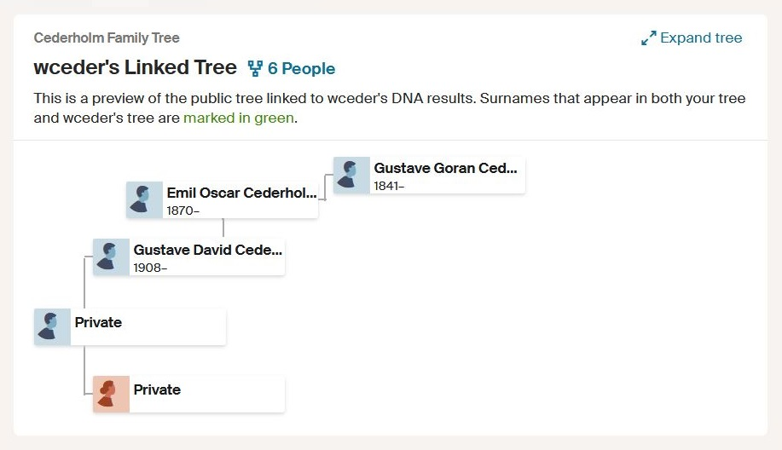

Slide 6
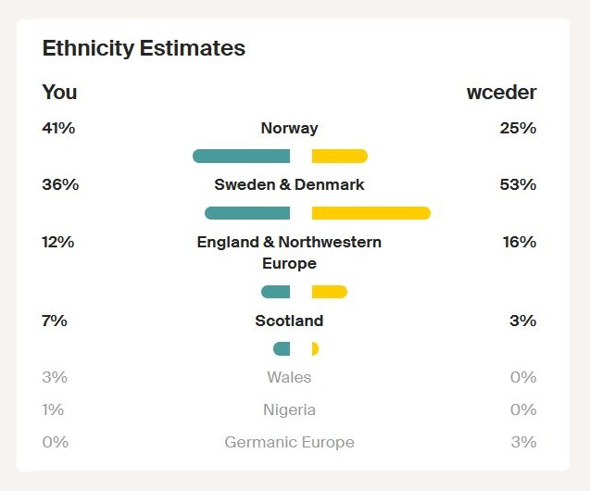

Slide 7
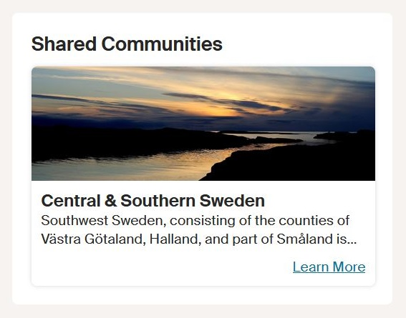

Slide 8
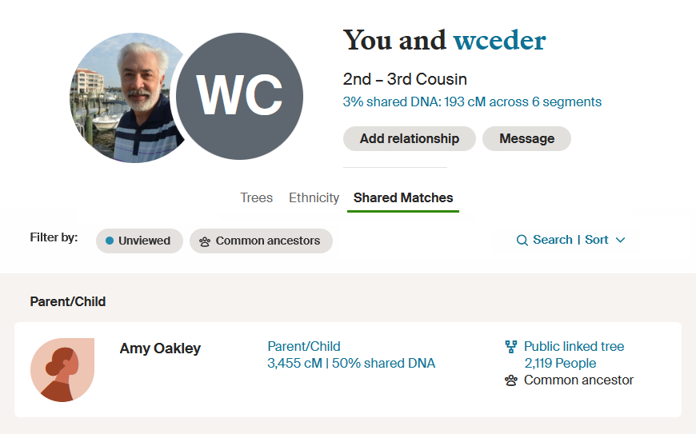
Amy’s DNA match with wceder is 179 cM

Slide 9
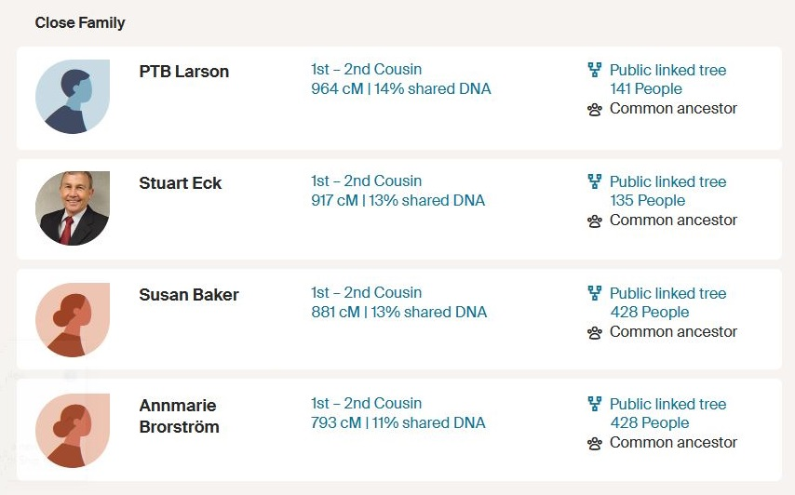
Shared DNA matches with my Brorström first-cousins
Their father and my mother were brother and sister

Slide 10
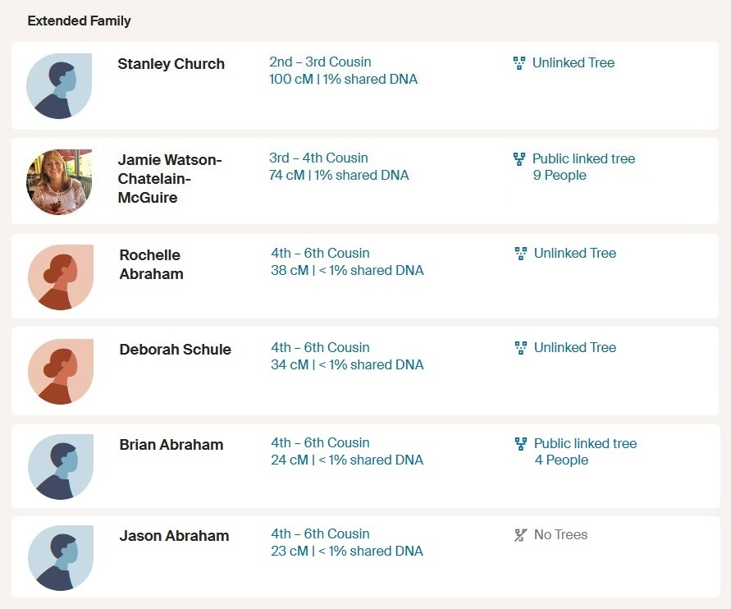
Shared DNA matches with other Cederholm descendants

Slide 11
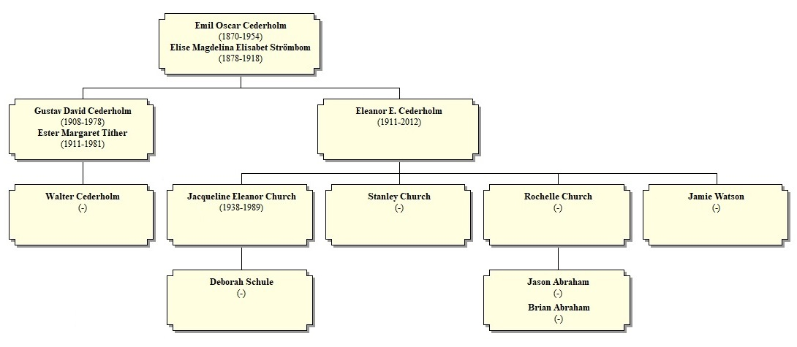
Emil immigrated to America in 1888

Slide 12
Shared DNA matches with Brorström descendants still living in Sweden

Slide 13
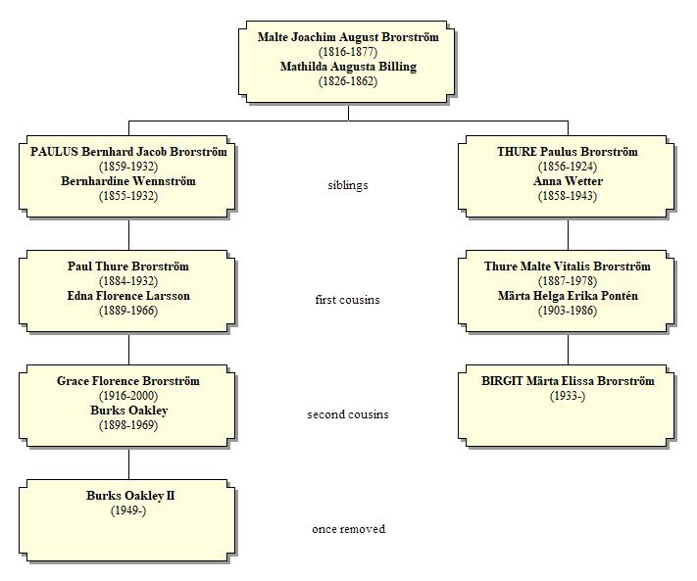

Slide 14
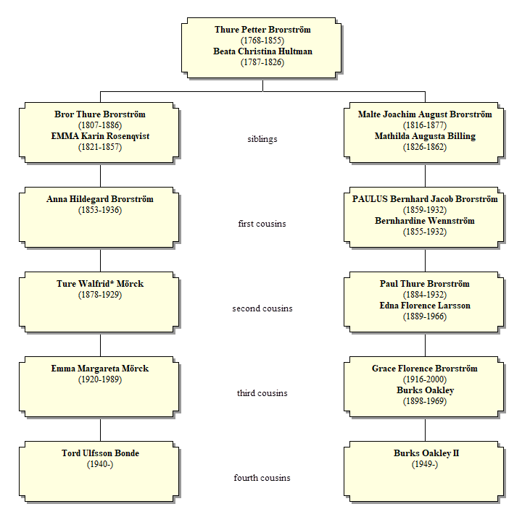

Slide 16
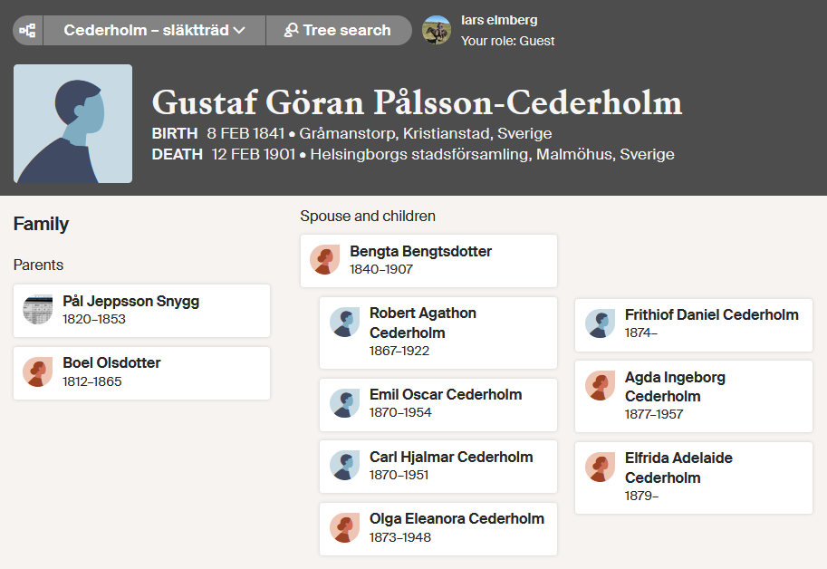

Slide 18
Gustav Göran Cederholm was born out of wedlock in 1841
His father could have been a Brorström
The obvious choice is Malte Brorström (1816-1877), my 2nd-great grandfather

Slide 19
Based on the overwhelming DNA evidence, I added Gustav Göran Cederholm to my family tree on Ancestry.com as a son of Malte Brorström.

Slide 20
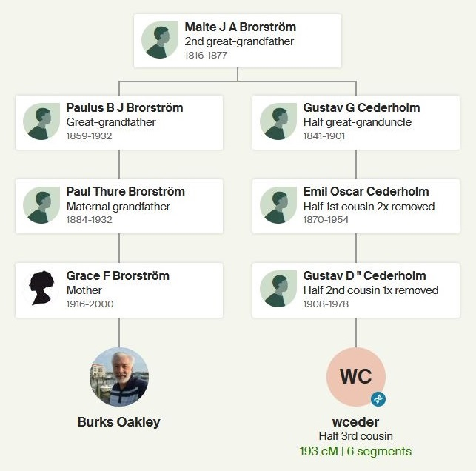
That gave the following relationship chart:

Slide 21
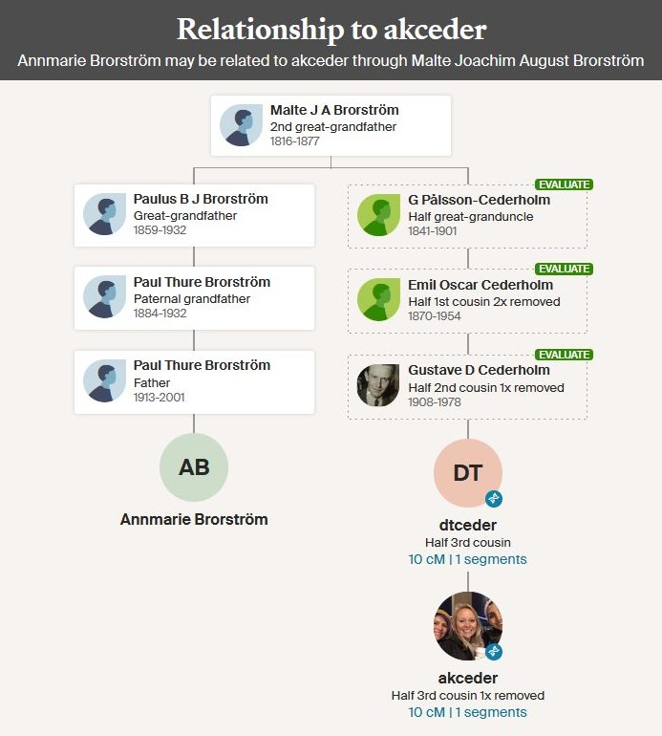
My first-cousin Annmarie Brorström has a DNA match with Annie K. Cederholm

Slide 22
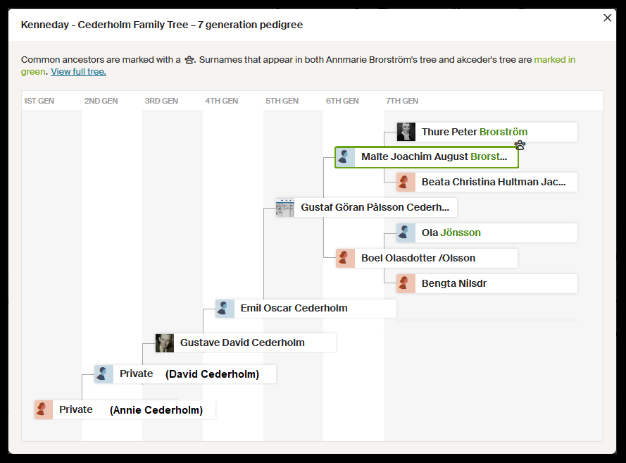
Annie K. Cederholm added Malte to her family tree

Slide 23
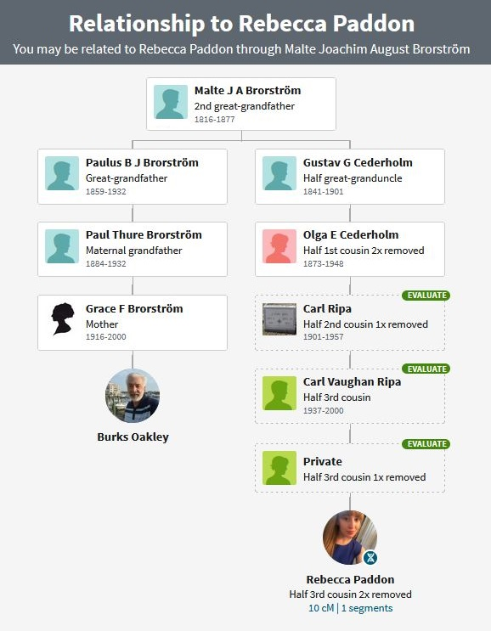
I have a DNA match with Rebecca Paddon

Slide 24
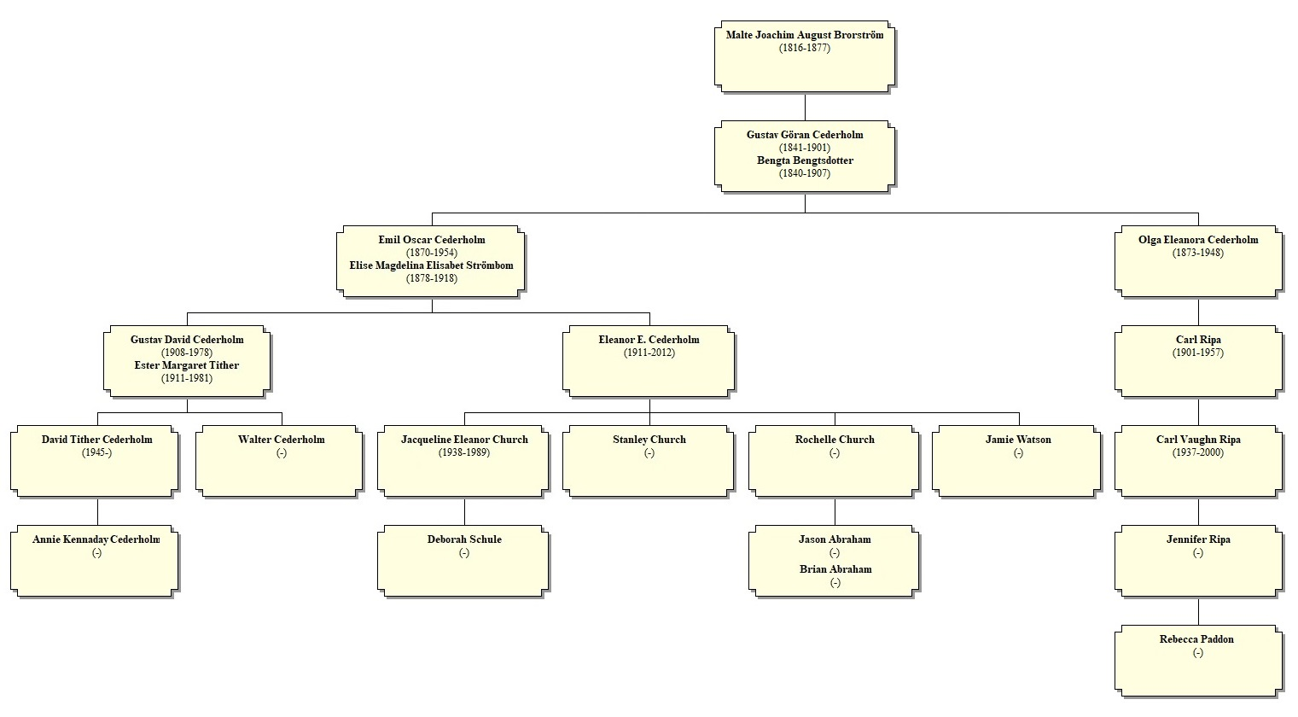

Slide 25
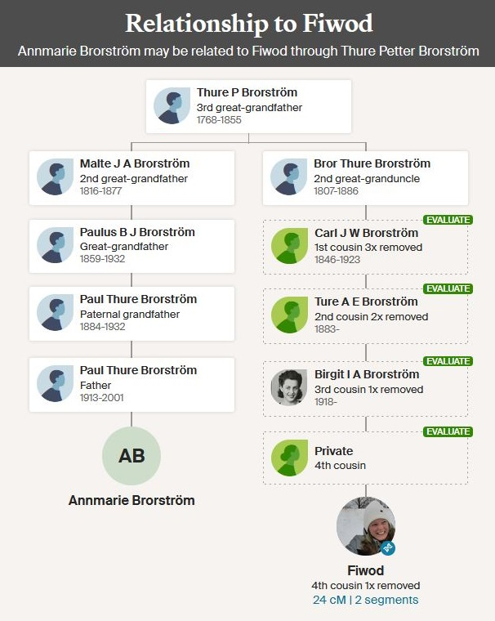
Annmarie Brorström has a DNA match with Sofia Wodstrup (Fiwod)

Slide 26
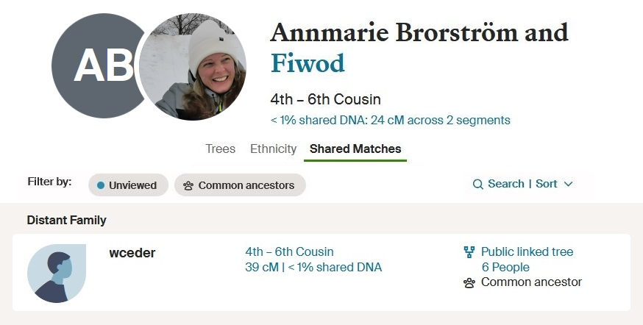

Slide 28
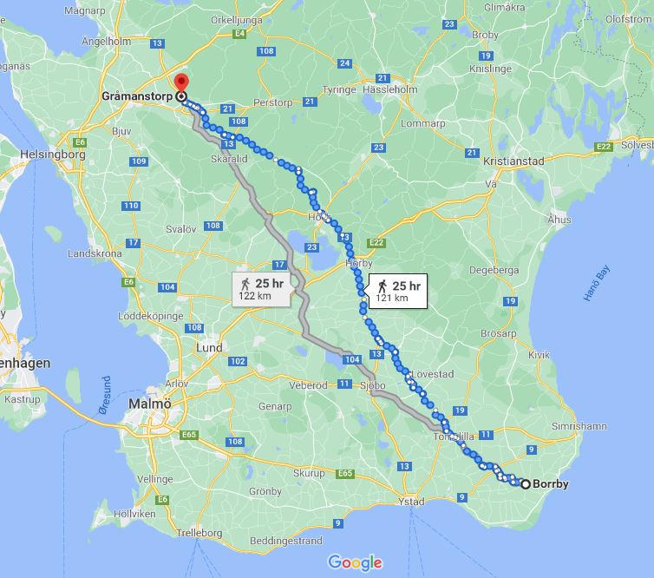
Boel
Malte

Slide 29
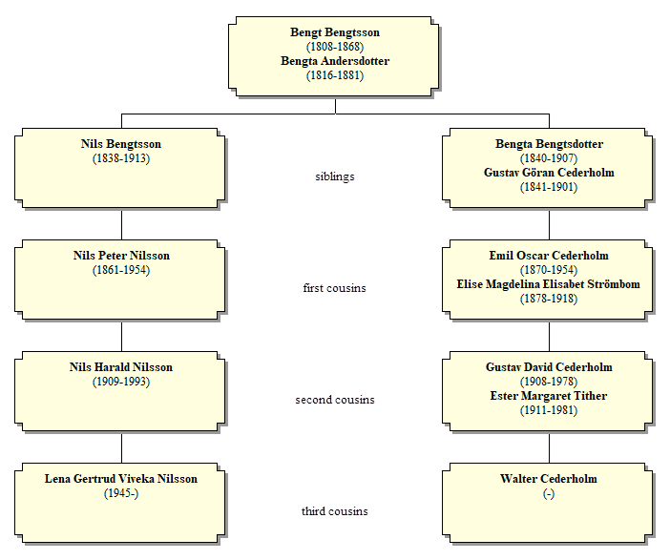
Lena Lundquist (nee Nilsson) is a third-cousin of Walter Cederholm
Lena has a DNA match with Annie Cederholm
Lena became interested in the idea that Malte Brorström was the father of Gustav Göran Cederholm

Slide 30
Lena Lundquist (nee Nilsson) thoroughly researched Boel (the mother of Gustav Göran Cederholm) and wrote a lengthy narrative about her:

Slide 31
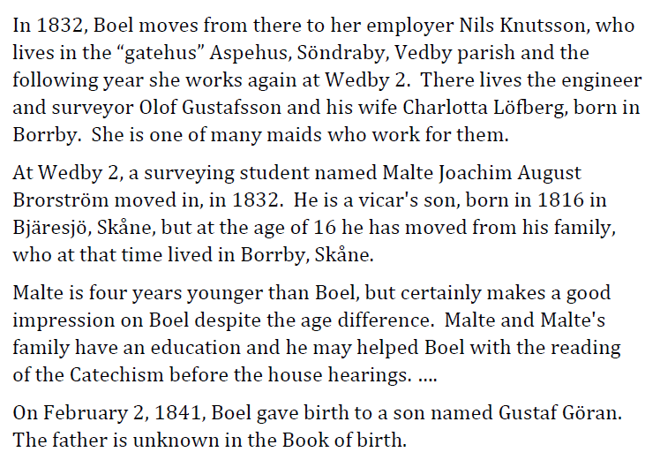

Slide 32
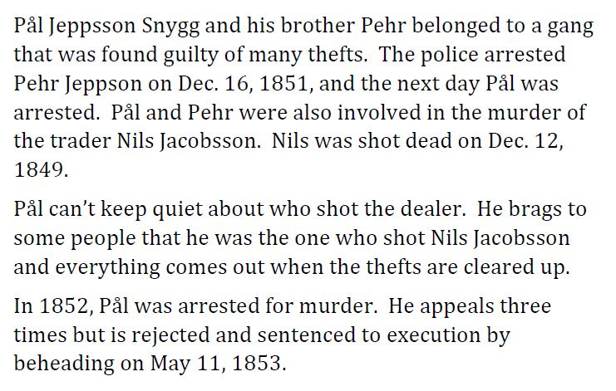

Slide 33
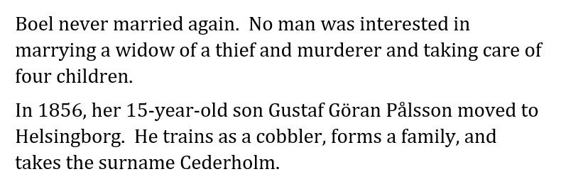

Slide 34
Malte Brorström lived in Borrby
At the age of 16, he went to Gråmanstorp to learn to be a surveyor
He apprenticed with Olof Gustafsson
Olof’s wife, Charlotta Löfberg, was born in Borrby
Boel worked for the Gustafssons as a maid.

Slide 35
Summary
I started with my DNA match with Walter Cederholm on Ancestry.com
We have shared DNA matches with many other Cederholm descendants AND Brorström descendants
Walter’s great-grandfather Gustaf Göran Cederholm was born out of wedlock in 1841
Based on DNA evidence, Malte Brorström was most likely the father of Gustaf Göran Cederholm
Malte studied to be a surveyor in the household where Boel was a maid.

Slide 36
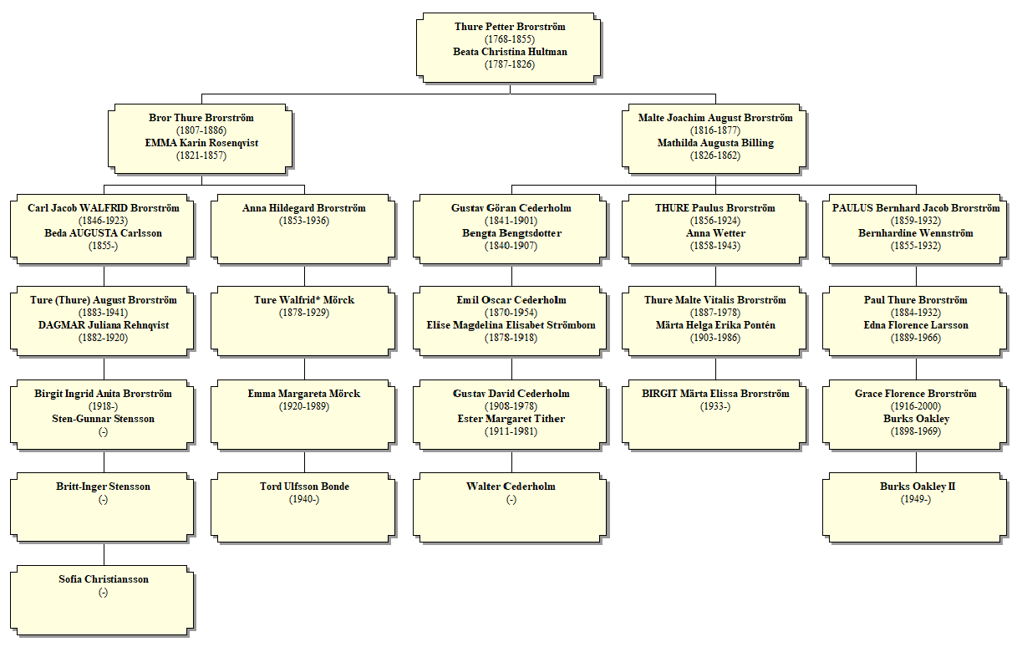

Slide 37
The DNA doesn’t lie!

Slide 38
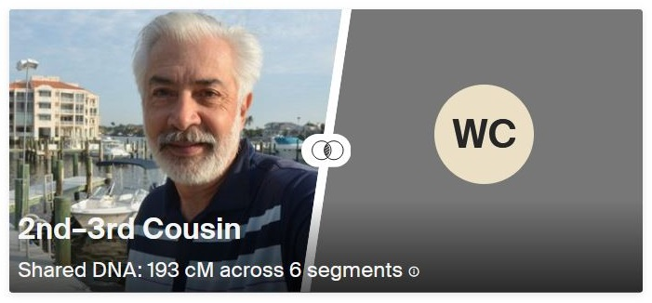
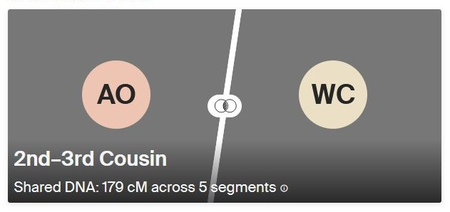
My DNA match with Walter Cederholm is 193 cM
My daughter Amy’s match with Walter Cederholm is 179 cM

Slide 39
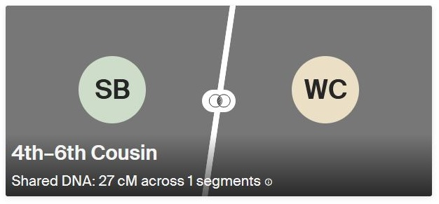
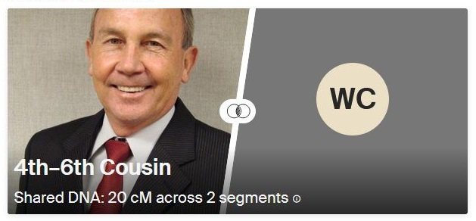
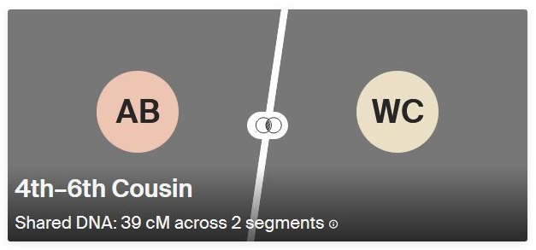
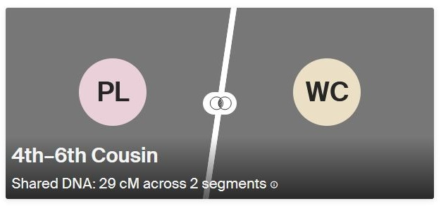
My Brorström first-cousins have much smaller matches with Walter Cederholm

Slide 40
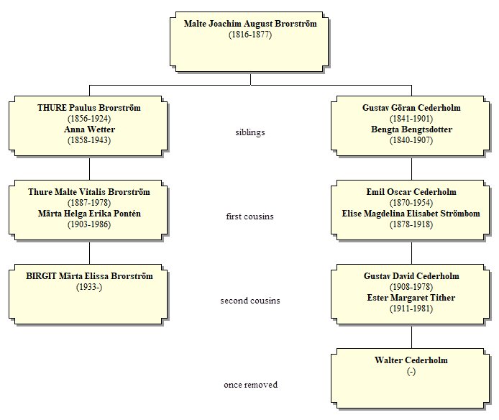
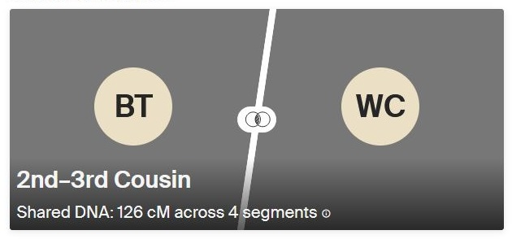
half-

Slide 41
